Slide 1
Substance Misuse and Addiction Resource for Tennessee
AN INITIATIVE OF THE UT INSTITUTE FOR PUBLIC SERVICE
Dr. Jennifer Tourville, Executive Director

Slide 2
Opioid Abatement Solutions
TCSA Legislative Conference May 24, 2023 Gatlinburg, TN

Slide 3
The “Three Buckets”
Total
Subdivision Fund – 15%
Abatement Fund – 70%
State Fund 15%

Slide 4
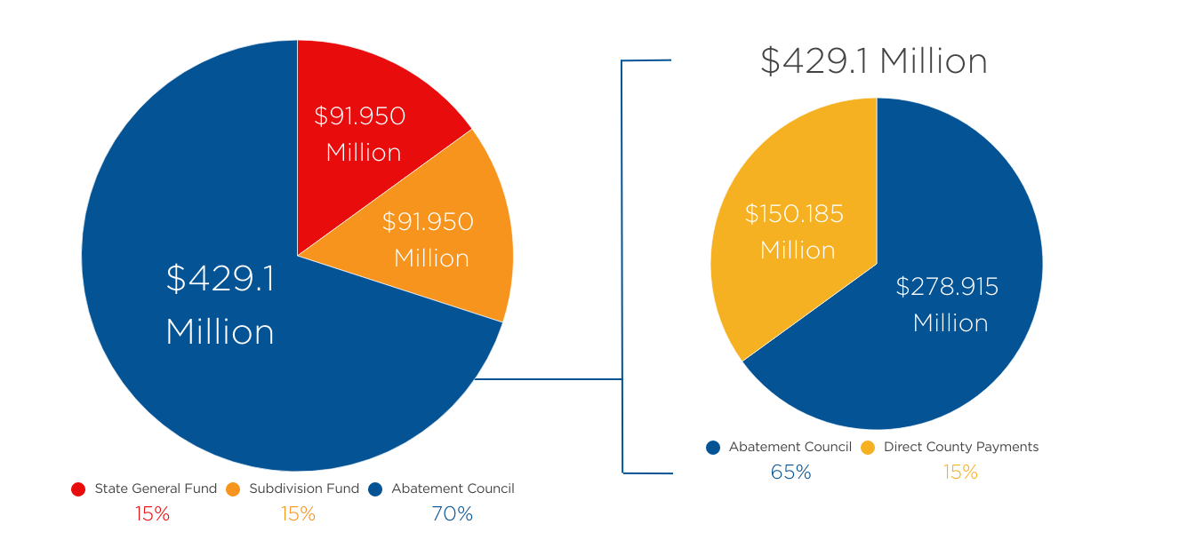
Total Current Settlement Amounts
Total of $613 million over 18 years

Slide 5
State Funds
15% of all settlements will go directly into the State General Fund to be used for opioid remediation.
Maximum total: $91.950
Distributors - $74.8 million over 18 years
J&J/Janssen - $17.1 million over 10 years
$91.95 Million
$91.95 Million
$429.1 Million
Source: https://www.tn.gov/content/dam/tn/attorneygeneral/documents/foi/opioids-settlements/guide.pdf

Slide 6
Subdivision Funds
15% of all settlements will be distributed among all subdivisions that signed onto the litigations
Allocations were set by the Plaintiff's Executive Committee based on impact and health expenditure metrics and will not change over time
Funds must be used for:
Future opioid remediation
Reimbursement for past remediation expenditures
Reasonable related administrative expenditures
Reporting – every 6 months to BrownGreer, only required if funds are spent on non-remediation purposes (first due March 31, 2023, if required)
Total maximum: $91.950 million
Distributors - $74.8 million over 18 years
J&J Janssen - $17.1 million over 10 years
$91.95 Million
$91.95 Million
$429.1 Million
Source: https://www.tn.gov/content/dam/tn/attorneygeneral/documents/foi/opioids-settlements/guide.pdf

Slide 7
Distributed Subdivision Funds - 2022
Source: https://www.tn.gov/content/dam/tn/attorneygeneral/documents/foi/opioids-settlements/guide.pdf

Slide 8
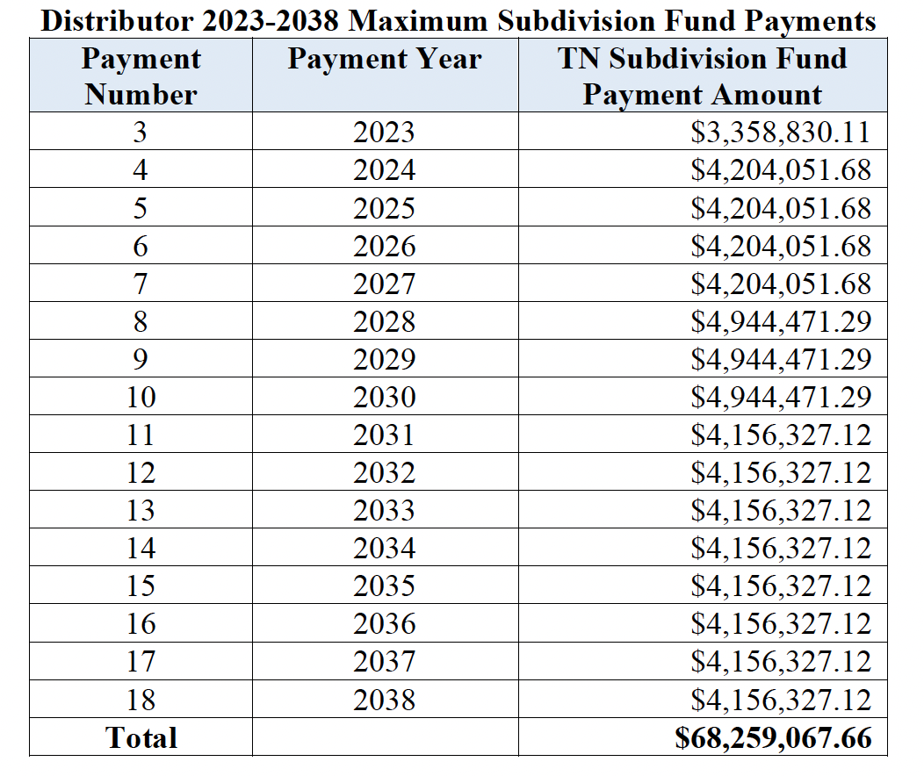
Future Subdivision Funds – Distributor
Source: https://www.tn.gov/content/dam/tn/attorneygeneral/documents/foi/opioids-settlements/guide.pdf

Slide 9
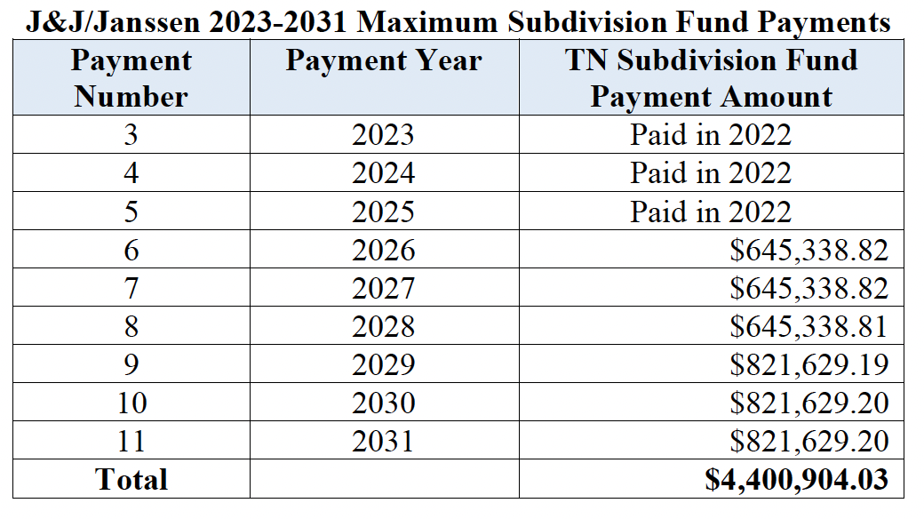
Future Subdivision Funds – J&J/Janssen
Source: https://www.tn.gov/content/dam/tn/attorneygeneral/documents/foi/opioids-settlements/guide.pdf

Slide 10
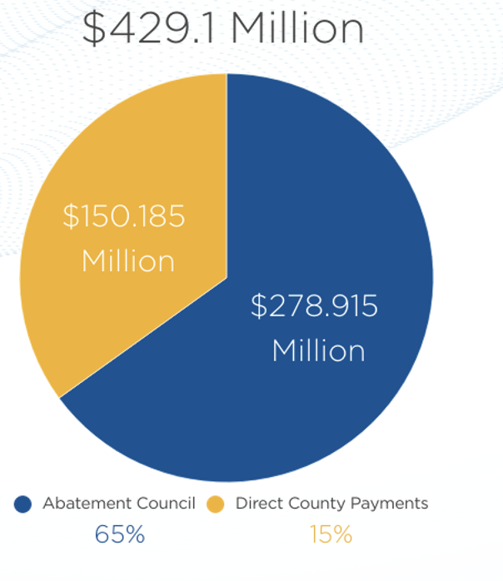
Opioid Abatement Council Act – 2021 PC No. 491: To establish the fund and assemble the council
Funds
15 voting members and 1 nonvoting member
Governor (4)
Council
Total max of $429.1 million
70% of all settlement monies
35% - $150 million directly to counties to be used for future opioid remediation
Speaker of the house (4)
Speaker of the senate (4)
TCSA (2)
TML (1)
Appointments:
65% - $278 million distributed through competitive grants
Council / abatement expenses
$150.185
Million
$429.1Million
$279.915
Million
Source: PC No. 491

Slide 11
Abatement Funds - County Allocations
In calculating the county allocation percentages, the data shall be weighted as follows:
12.5%
Fatal overdose, 3 years TDH
12.5%
Nonfatal overdoses, 3 years TDH
25%
Opioid prescriptions per person, 3 years TDH
50%
Population, 2020 US Census
Source: TN state-subdivision opioid abatement agreement

Slide 12
County Allocation Data
Population 35,999
Source: https://www.tn.gov/health/health-program-areas/pdo/pdo/data-dashboard.html

Slide 13
County Allocations
Recalculating
2% Holdback
Per the 2021 Opioid Abatement Council Act the allocation percentages will be updated every 4 years using the same data points.
Next calculation prior to 2027 payment
Because it is possible that the data may not represent the scope of the problem in very small counties, 2% of the total county abatement funds will be held back for possible appeals
Source: https://www.tn.gov/content/dam/tn/attorneygeneral/documents/foi/opioids-settlements/guide.pdf

Slide 14
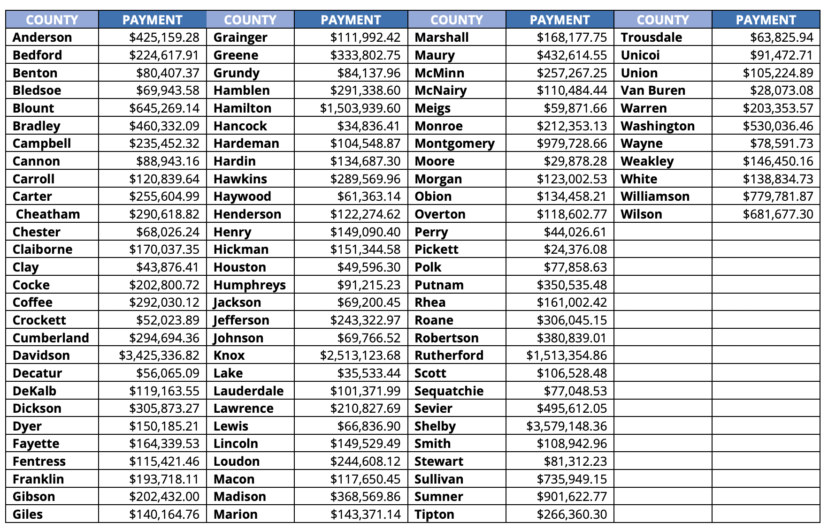
County Abatement Payments - 2023
Total of $31,425,152.80 distributed
Source: https://www.tn.gov/content/dam/tn/mentalhealth/documents/OAC_2023_County_Funding.pdf

Slide 15
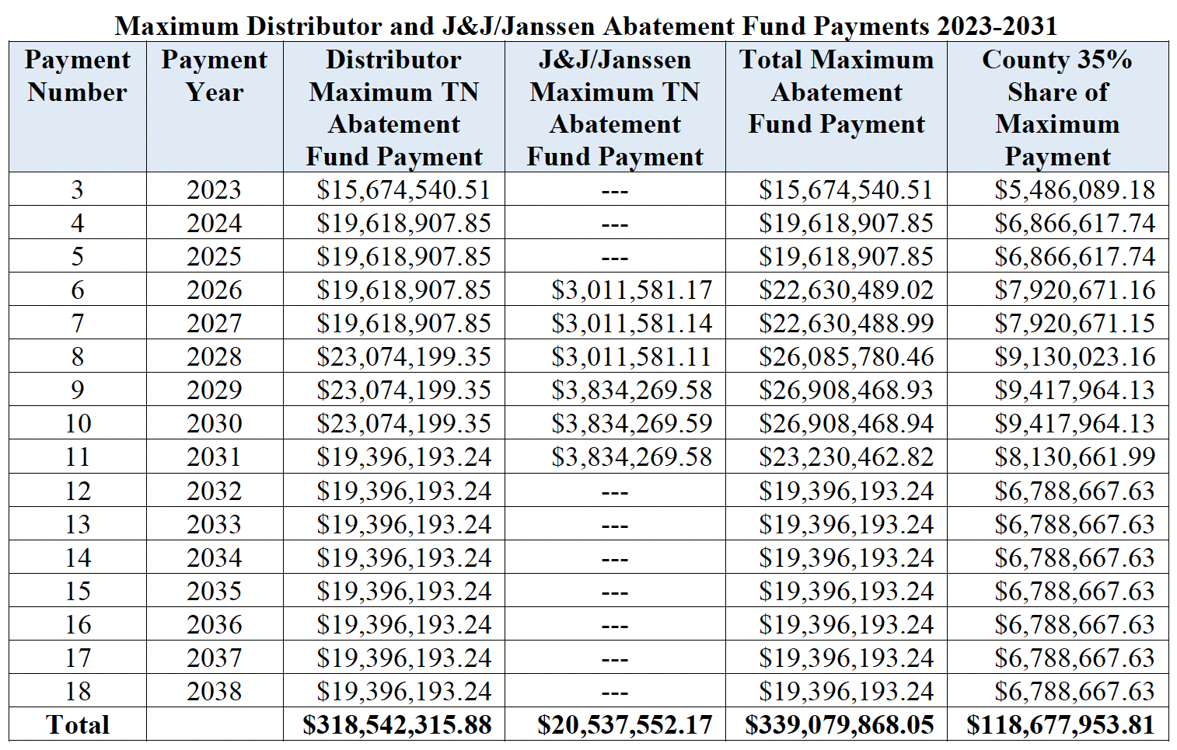
Future Abatement Payments – J&J/Distributor
Source: https://www.tn.gov/content/dam/tn/attorneygeneral/documents/foi/opioids-settlements/guide.pdf

Slide 16
Abatement Funds – County Reporting
Biannual Reporting
Reporting required directly to OAC
What remediation strategies the county funded
Total amount spent on each strategy
When the funds were spent
Number of people served

Slide 17
Approved Remediation Uses Core Strategies
In settlement agreements and approved by TN OAC in 2022
Naloxone or other FDA-approved drugs to reverse overdose
Medication assisted treatment
Services for pregnant and postpartum women
Expand treatment for NAS
Expand warm hand-offs and recovery services
Treatment for incarcerated population
Prevention programs
Expanding syringe service programs
Data collection and research analysis of abatement strategies
Source: TN OAC Approved Remediation List

Slide 18
2nd Wave Settlements – $490 Million
Subdivisions had to sign on by April 18th, 2023
Distributors and Pharmacies
2023 introduced legislation
Allergan - $57 million over 7 years
Teva - $96 million over 13 years
CVS - $127 million over 10 years
Walgreens - $138 million over 15 years
Walmart - $72 million in one payment
HB1367/SB0637
Adds these five additional companies to the statewide opioid settlement agreement.
Amends TCA so that the second wave monies will be subject to the same rules as the first wave and will be distributed in the same way.
Source: TN AG site, HB1367

Slide 19
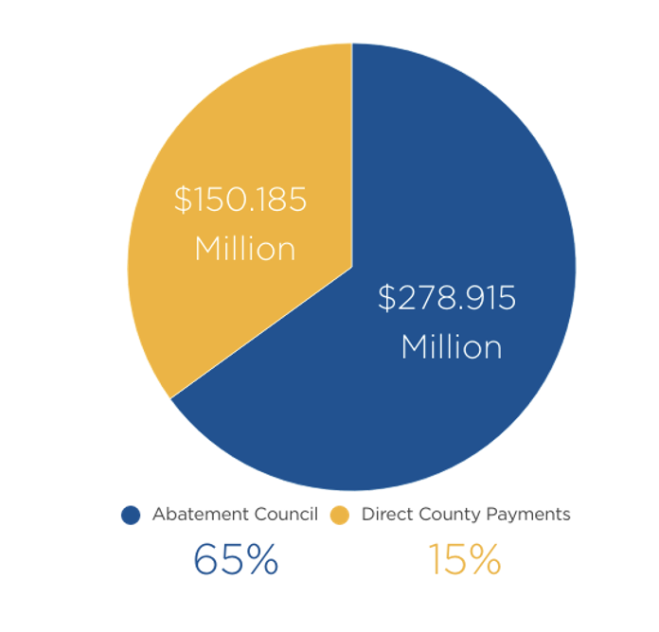
Abatement Funds – Community Grants
Per the Abatement Act: The council shall disburse the remaining 65% of such proceeds for statewide, regional, or local opioid abatement and remediation purposes
2023: $72 million available for distribution
Approved remediation uses the same as county
Hoping to accept applications fall 2023
Reporting to be determined by OAC
Source: TN Abatement Act

Slide 20
Endo Bankruptcy: Pending
No action need from counties at this time
The TN Attorney General’s office will provide additional information as it becomes available
It is possible that a proof of claim will be needed from counties at a later date

Slide 21
Assemble a Task Force 5-7 Reps
Local elected officials
Reps from diverse populations
Service providers
County agency leaders
People with lived experience
University Reps

Slide 22
Johns Hopkins Five Guiding Principles
Spend money to save lives
Use evidence to guide spending
Invest in youth prevention
Focus on racial equity
Develop a fair and transparent process
Source: Johns Hopkins Guiding Principles

Slide 23
Conduct a Local Needs Assessment
Determine how to disburse limited resources for maximum impact
What?
Systematic process for identifying health needs and assets – which interventions save the most lives
Who?
Often health department in partnership with other organizations
When?
SAMSHA recommends conducting every three years
Why?
To ensure settlement funds create a sustainable, long-term reduction in substance use disorder
Source: NACO/JH Guide for conducting a needs assessment

Slide 24
Use funds to leverage funds
Collaborate with other counties when possible
Evaluate programs
Transparency and talking to the public

Slide 25
IPS SMART Consultants
Starting July 2023 in each grand division
Plans for opioid settlement funds
Program implementation
Education for community stakeholders
Grant writing and management
Program evaluation

Slide 26
SMART.Tennessee.edu
SMART@Tennessee.edu

